Slide 1
SVD in Image Compression
By: Reagan, Siera, Serenna

Slide 2
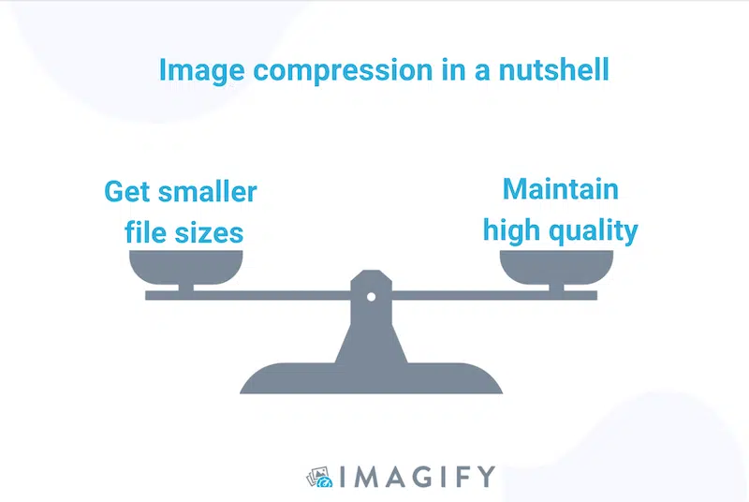
What is the goal?
Notes:
Serenna

Slide 3
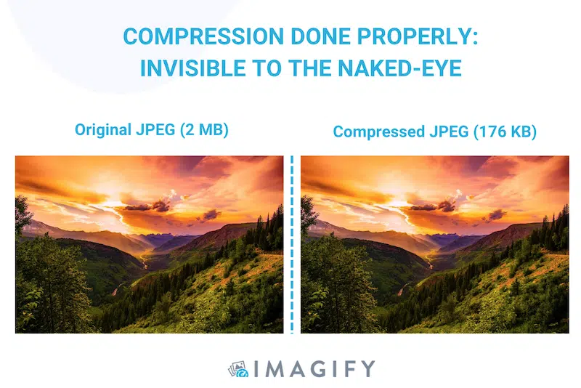
Background
“The objective of image compression is to reduce irrelevance and redundancy of the image data to be able to store or transmit data in an efficient form. It is concerned with minimizing the number of bits required to represent an image.”
-ScienceDirect
Notes:
Serenna

Slide 4
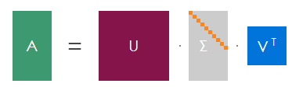
Basic SVD Review
Definition: Every m x n matrix A can be expressed as a product of U, Σ, and V.
U and V are orthogonal matrices.
U entries = right singular values as vectors
V entries = left singular values as vectors
Σ is a pseudo-diagonal matrix.
Σ entries = singular values
Notes:
Reagan

Slide 5
SVD in the Lense of Linear Transformations
If A is an mxn matrix then:
A=UΣV^{T}
U: Rotation
Sigma: Linear Transformation, Scaling and Vertical/Horizontal Shift
V: Rotation
First conduct V^{T} then Σ then U.
Notes:
Reagan: Add use board potentially?

Slide 6
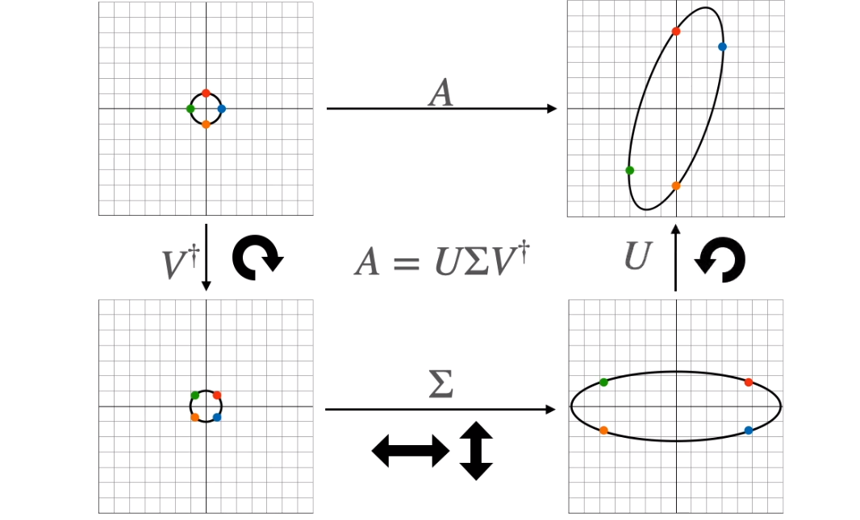

Slide 7
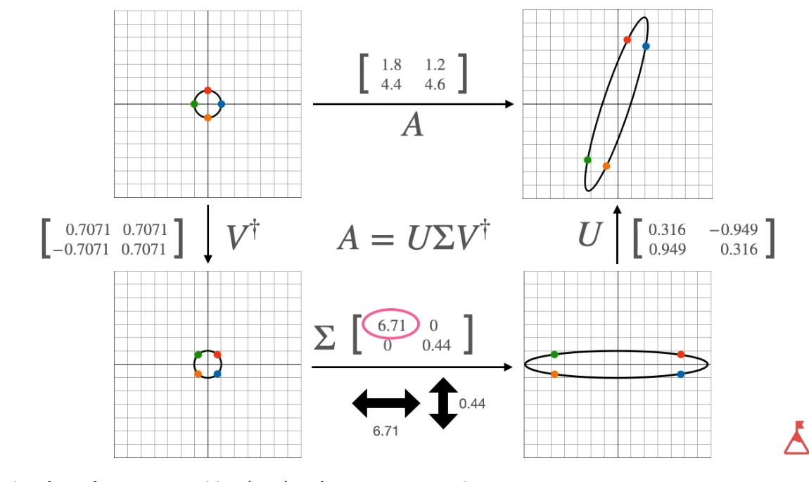

Slide 8
Increasing Rank 1 Matrices
Decomposition into sum: Matrix Multiplication
A=UΣV^{T} = σ₁u₁(v₁)^{T}+ σ₂u₂(v₂)^{T} + … + σ_{r}u_{r}(v_{r})^{T}
The best rank k approximation of A
A(k) = σ₁u₁(v₁)^{T}+ σ₂u₂(v₂)^{T} + … + σ_{k}u_{k}(v_{k})^{T}
Having a higher k value (# of rank 1 matrices) leads to having a clearer image when it gets multiplied out.
Notes:
Reagan

Slide 9
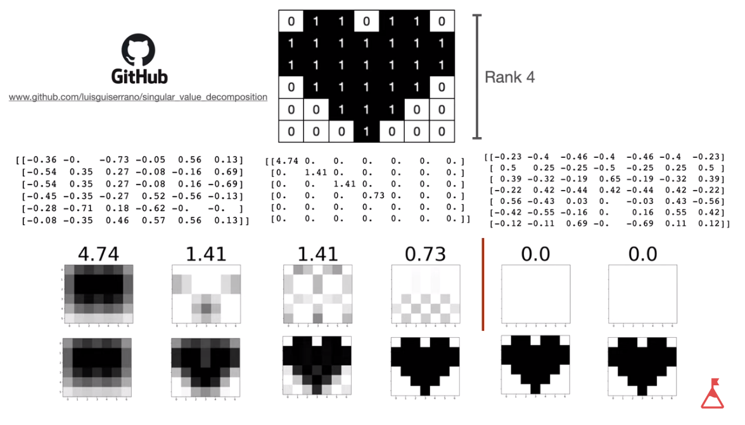
Notes:
Reagan - top of two rows is rank #, second row is sum of rank #s

Slide 10
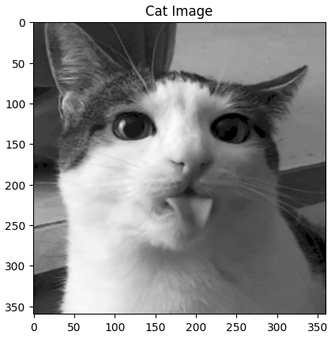
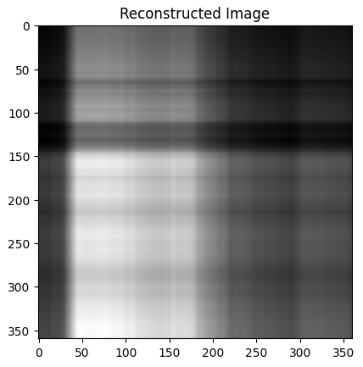
Image Compression with Black and White
An image is stored as a matrix of integers.
Since the image is black and white, each integer represents the brightness of a pixel.
A = Matrix of shade integers
Notice the bright areas in the reconstructed image are in the same areas as the original image!
Notes:
Serenna

Slide 11
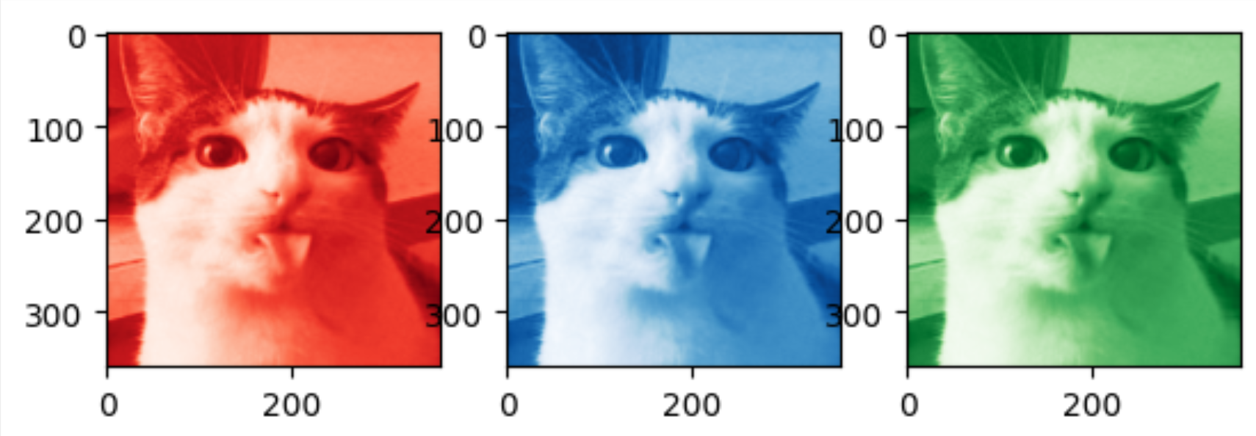
Image Compression with Color
Separate into 3 different matrices.
Red, Blue, Green (most common)
Hue, Saturation, Value
Save singular value approximation for each matrix.
To bring the image together again, multiply out decomposition into the approximation of the original matrix, then combine color values from each matrix.
Notes:
Siera
Usually this is done using a computer program like Python, especially to keep track of all the color values.

Slide 12
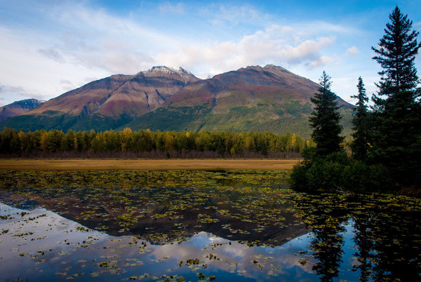
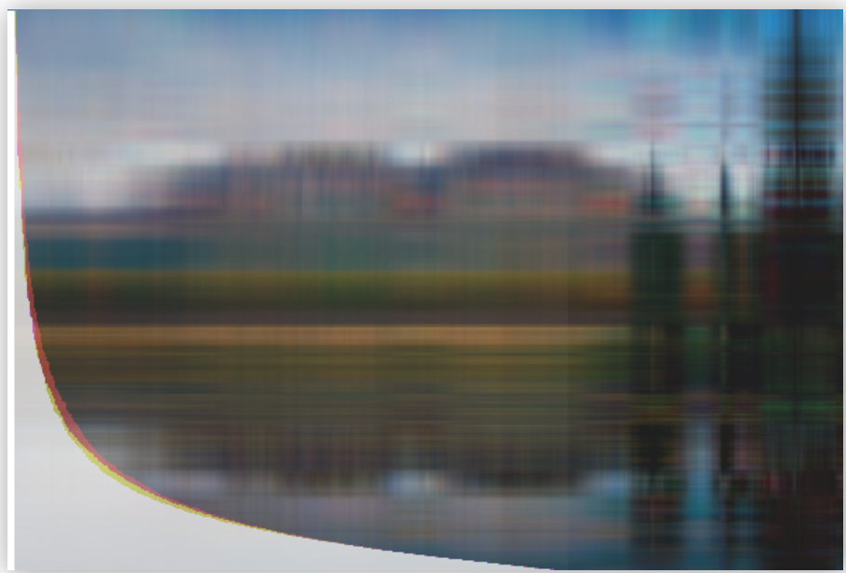
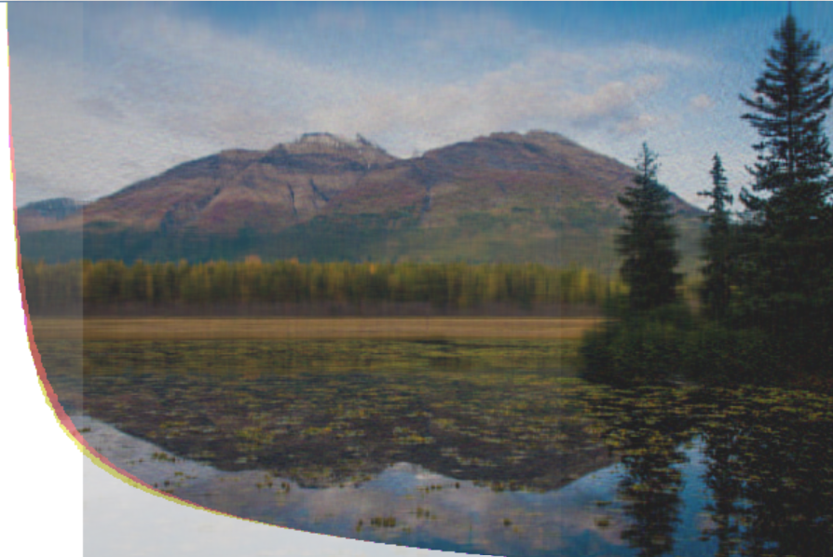
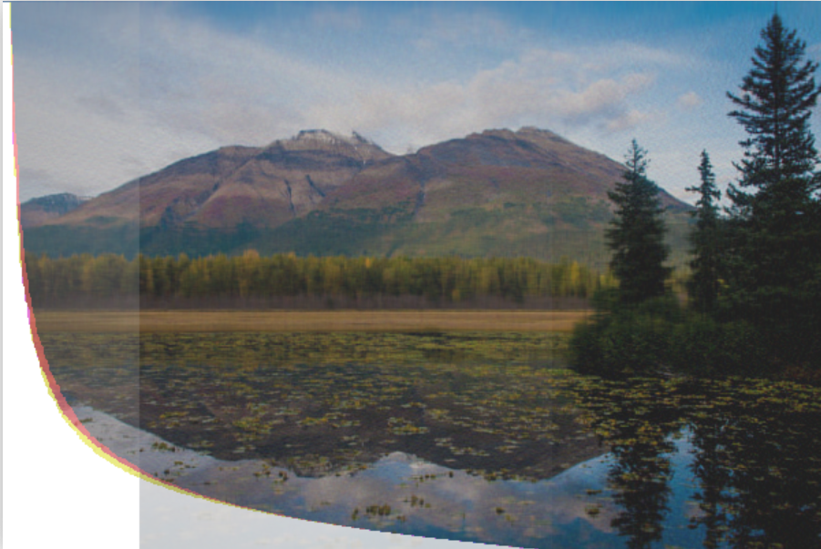
How is it more efficient?
Image size: 600 × 402
Pixels: 241,200
Pixels: Singular Values:
6,018 6
Pixels: Singular Values:
60,180 60
Pixels: Singular Values:
100,300 100
Notes:
Siera - Curve represents the value of the singular values. This is significant because for SVD, the singular values are ordered from largest to smallest, beginning with the largest. Like Raegan explained, this means that the first matrix contains the most information, slowly decreasing from there. Usually,
Regular:
Image Size: 600 × 402
Pixels Count: 241200
Compressed
Pixel Count with 20 singular values: 10030
Pixel Count with 60 singular values: 60180

Slide 13
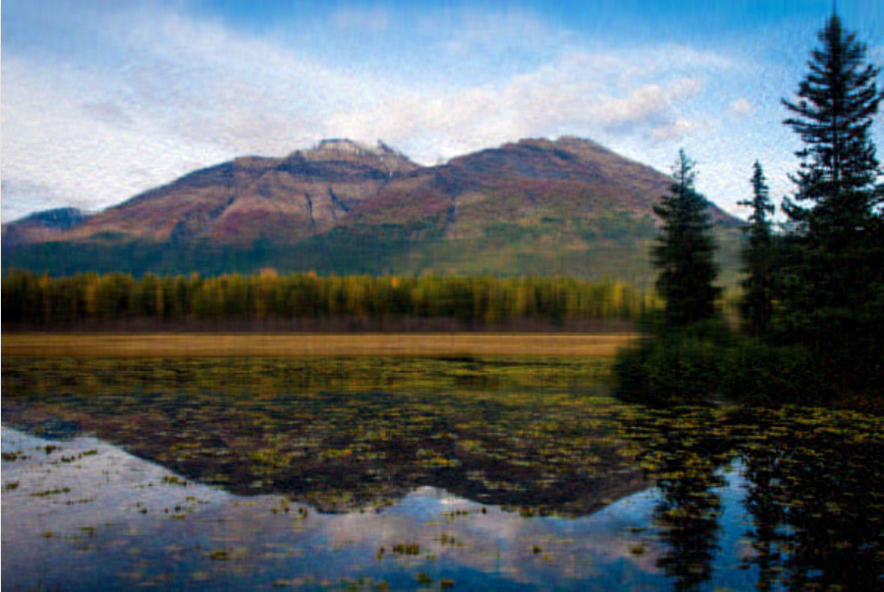
Taking a closer look
Original Image: Compressed Image:
Pixels: 241,200 Pixels: 60,180

Slide 14
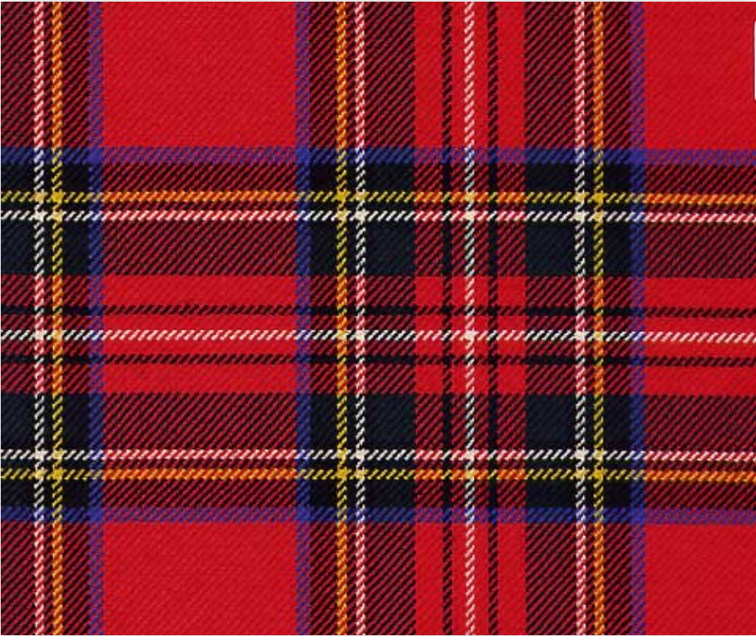
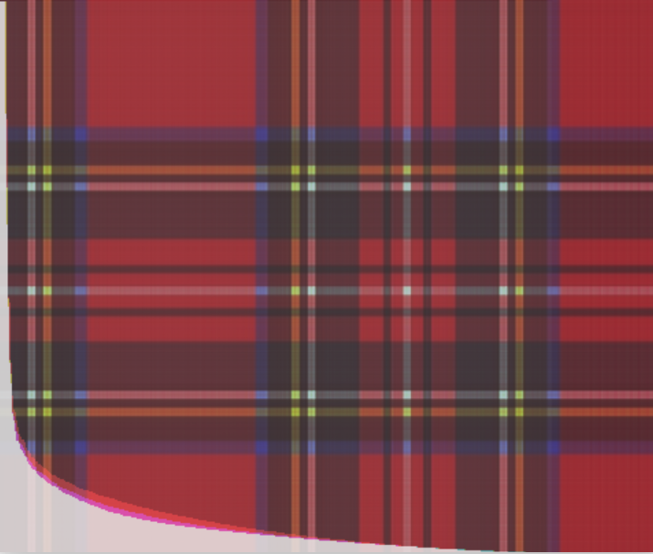
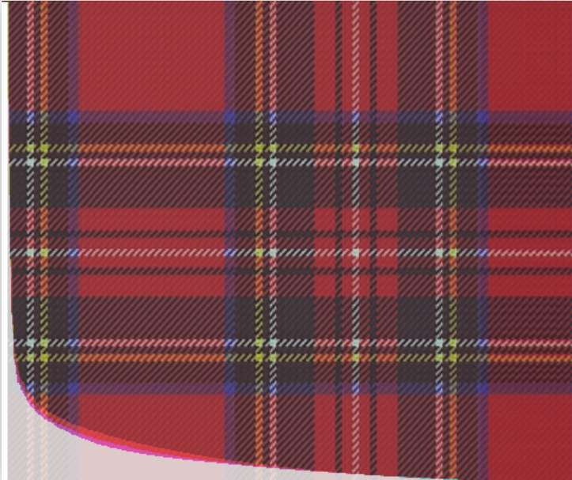
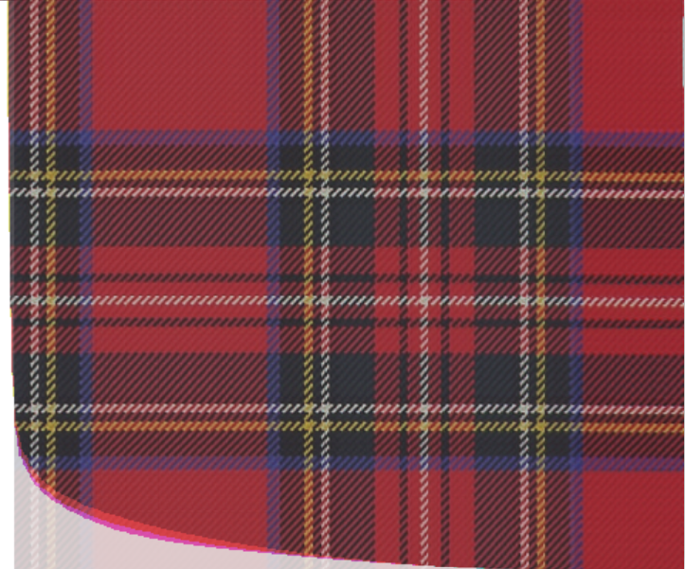
Another Example
Image size: 481 × 404
Pixels: 194,324
Pixels: Singular Values:
886 1
Pixels: Singular Values:
4,430 5
Pixels: Singular Values:
8,860 10

Slide 15
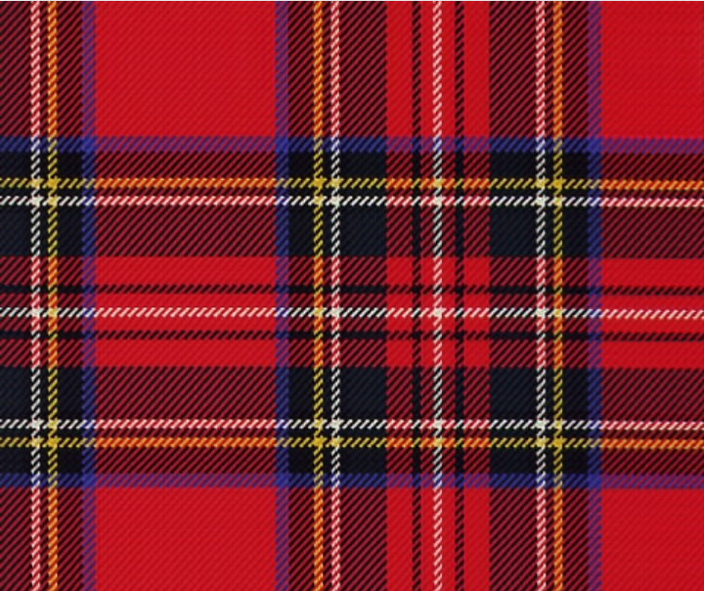
Original Image: Compressed Image:
Pixels: 194,324 Pixels: 8,860

Slide 16
Where is it used?
Lossless
All data is preserved.
Archive Databases
Medical imaging
Technical drawings
Lossy
Removes unnecessary data to reduce file size.
Natural Images
Photographs
Notes:
For lossless, you are keeping the SVD which includes every rank 1 matrix for each singular value.
For lossy, you are choosing an approximation you declare to be “best” and then find the rank k approximation for it. The rest of the singular values can be forgotten.

Slide 17
Bibliography
No author given. (2023, December 17). SVD Image Compression, Explained. dmicz devblog. https://dmicz.github.io/machine-learning/svd-image-compression/.
Baumann, T. (n.d.). Image Compression with Singular Value Decomposition. Tim Baumann. https://timbaumann.info/svd-image-compression-demo/.
Pu, I. M. (2006). Image Compression. Science Direct. https://www.sciencedirect.com/topics/computer-science/image-compression#:~:text=The%20objective%20of%20image%20compression,required%20to%20represent%20an%20image.
No author. (2021, January 13). Compressing images with singular value decomposition (SVD). ZeroBone. https://zerobone.net/blog/cs/svd-image-compression/.
Serrano Academy. (2020, September 8). Singular Value Decomposition (SVD) and Image Compression. YouTube. https://www.youtube.com/watch?v=DG7YTlGnCEo&t=1657s.
No author. (2024, March 7). What’s Image Compression and How It Works. Imagify Blog. https://imagify.io/blog/image-compression/.
Notes:
Detail about singular value decomposition, curve emphasis on slide with pictures, original pixel count on slide with pixels, emphasize best rank k matrix

